Slide 1
Welcome to Year 7
'To seek wholeness through faith, quest and learning to be what God intends us to be.'
R | I | S | E
RESPECT RESILIENCE | INTEGRITY | SELF-DISCIPLINE | EXCELLENCE

Slide 2
Our School Prayer
Thank you Father for our school,
help us learn to value,
learn to give,
learn to achieve,
and grow in the Peace of Christ.
Amen
R | I | S | E
RESPECT RESILIENCE | INTEGRITY | SELF DISCIPLINE | EXCELLENCE

Slide 3
St Benet Biscop students are respectful and kind and celebrate the uniqueness of each individual. | St Benet Biscop students ‘stick at it’ remain positive and have the strength to persevere. | St Benet Biscop students are truthful and honest in all areas of life. | St Benet Biscop students follow the rules; first time, every time. | St Benet Biscop students work hard and persevere to be the best version of themselves.
Respect R | Resilience R | Integrity I | Self-Discipline S | Excellence E
Respect each other's uniqueness | Mistakes are opportunities to learn | Do as you are asked the first time of asking | Respect each other | High Expectations
Respect the environment | Have a positive attitude | Truthful and honest | Be ready for the school day | Determined to get better

Slide 4
St Benet Biscop RISE up and SHINE to our Mission
RISE UP and SHINE
St Benet Biscop students show faith in themselves, each other, staff and God. They use their God given gifts to be the person God intended them to be. | St Benet Biscop students enrich and enhance their lives by engaging in extracurricular and careers activities to help them on their journey. | St Benet Biscop students are ready to learn and take pride in their class work and homework. They are prepared and have the correct equipment.
FAITH | QUEST | LEARNING
Have faith in God, yourselves and others | Rise up and Shine | Be engaged in your learning
Participate in daily worship | Participate in activities beyond the classroom | Be ready for lessons and learning
To seek wholeness through faith, quest and learning to become what God intends us to be.

Slide 5
Y7 Clubs Autumn Term
Before School
Monday | Tuesday | Wednesday | Thursday | Friday
Breakfast club - open to all students each day 8-8.30am
Music Practice - All Years - Each day 8-8:40am - Music Department
After School
Monday | Tuesday | Wednesday | Thursday | Friday
 | Volleyball Club Year 7-11 Week A and B | Girls Football Year 7-11 Week A and B |  | Basketball Club Year 7-11 Week A and B
 |  | Boys Football Year 7 and 8 Week A and B | Boys Rugby Year 7-11Week A and B
 |  |  | Girls Netball Year 7-10 Week A and B
SEND hmk/detention in learning suport to invited students
Homework club - LRC AIT6 | Homework club - LRC AIT6 | Homework club LRC AIT6 | Homework club LRC AIT6
 | Show Rehearsal All years Drama Studio 1/2/Music Room 1 | Show Rehearsal All years Drama Studio 1/2/Music Room 1 | Show Rehearsal All years Drama Studio 1/2/Music Room 1
 |  | School Band All Years Music Room 1 invitation/Audition
R | I | S | E
RESPECT RESILIENCE | INTEGRITY | SELF DISCIPLINE | EXCELLENCE

Slide 6
Y7 Clubs Autumn Term
Monday | Tuesday | Wednesday | Thursday | Friday
Warhammer Club. Year 7. Week B W004. Food can be brought Pass from Mr Hatcher | Y7 reading/book club The library Week A&B Tues 2nd lunch. Early lunch pass from Miss Yorke. | Board Game Club. Week B H101. Food can be brought Pass from Mr Floyd. | Warhammer Club . Year 7. Week A W004. Food can be brought Pass from Mr Hatcher | Singing club
Volleyball Club Year 7 Week B | Y7 Spanish Club, A and B, Food can be brought, pass from Mr Jones | Maths club. Y7. A and B. No food, go to hall first, get pass. AIT2 with ATT and VGA | Singing Club (Year 7, 10, 12, 13). Week B . Food can be brought. Pass from Mrs Anderson. BDS2.
Singing Club (Year 7, 10, 12, 13). Week A . Food can be brought. Pass from Mrs Anderson. BDS2. | School Show - Principal Singing Rehearsals Week B - Y7/11/12/13 by audition |  | Duolingo Club, Week A and B, must eat before coming, Pass from Mrs Johnson
Chaplaincy club. Y7. Week A and B. Food can be brought. Chapel. Pass from Bridgid. | Band Rehearsal -Y7/10/12/13 BMU1 Week A |  | School Show - Principal Singing Rehearsals Week B - Y7/10/12/13 by audition
Year 7 Proggy club. Term 1.Chapel. Food can be brought. Pass from Ms Lewis-Dale
School Show - Principal Singing Rehearsals Week B - Y7/11/12/13 by audition
Band Rehearsal -Y7/10/12/13 BMU1 Week A
R | I | S | E
RESPECT RESILIENCE | INTEGRITY | SELF DISCIPLINE | EXCELLENCE

Slide 7
Mrs L Banfield – Assistant Headteacher
Our Curriculum – Ambition for All
Taught by specialists, our Year 7, 8 and 9 curriculum prepares our students for the challenges of Key Stage 4 and from the outset in Year 7, is tailored to support and develop the necessary knowledge and skills our students will need to be successful.
Religious Education is at the centre of the curriculum.
R | I | S | E
RESPECT RESILIENCE | INTEGRITY | SELF DISCIPLINE | EXCELLENCE
Notes:
Taught by specialists, our Year 7, 8 and 9 curriculum prepares our students for the challenges of Key Stage 4 and from the outset in Year 7, is tailored to support and develop the necessary knowledge and skills our students will need to be successful. Furthermore, it provides additional stretch and challenge to the most able, whilst ensuring that provision is in place to ensure those that need to catchup, do so quickly. Our curriculum embraces students of all ability and encourages challenge and high expectation for all: supporting and stretching all students to be the best they possibly can be.

Slide 8
The Key Stage 3 Curriculum
Religious Studies
English
Mathematics
Science
Art
Drama
Geography
History
IT/Computing
Modern Foreign Languages (French, Spanish)
Music
Physical Education
Technology (Textiles, Food & Nutrition and Product Design)
​
Students also study personal, social, health, and citizenship education (PSHCE), through regular, weekly Core Studies lessons.
Notes:
KS3 is the building blocks for study later on – feels like a very long time away, can promise you it will fly.
Students pick their options in year 9, and until then we assume that students will continue to study all subjects until the age of 11. This is for several reasons, firstly because they change their mind – keep doors open, secondly because KS3 is important in it's own right. Some things you need to know for life.

Slide 9
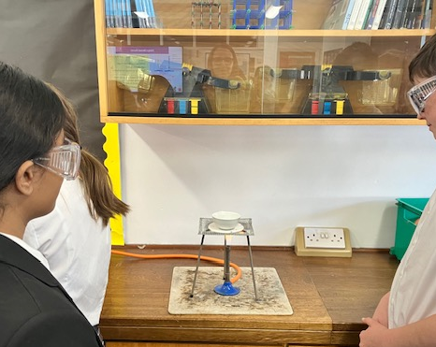
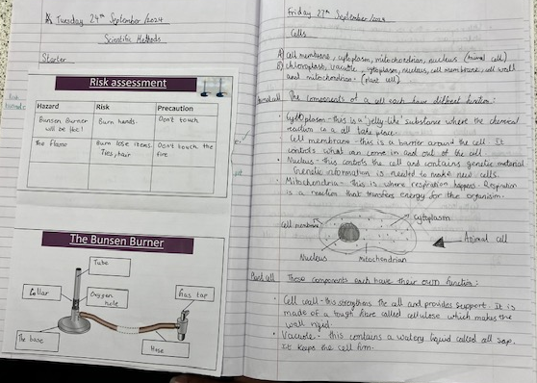
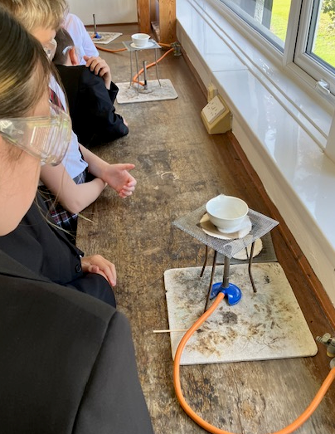
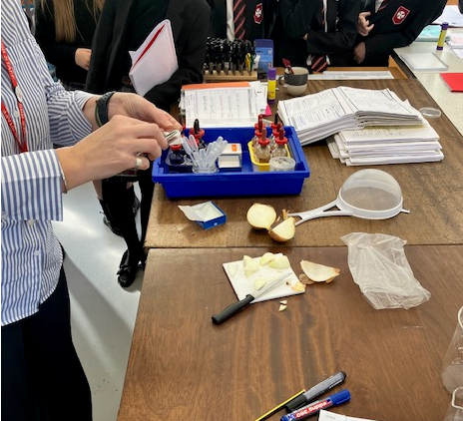
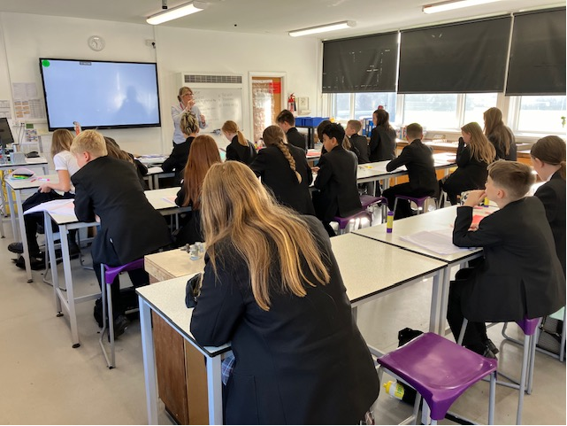
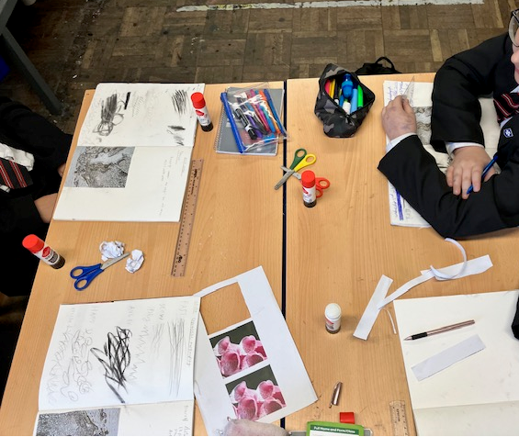
Notes:
Privilege – being out and about in classrooms. Focus is on learning. Not friendships, not gossip – learning.
We aim to get the balance right – between fun and love of learning, and academic rigour – preparing for the challenges ahead.

Slide 10
Our lessons are designed to support students with the acquisition of new knowledge, and remembering knowledge over time, so that they are able to apply this knowledge, and make great progress through our planned curriculum.
Promoting reading, communication skills and understanding of vocabulary are at the heart of the curriculum.
R | I | S | E
RESPECT RESILIENCE | INTEGRITY | SELF DISCIPLINE | EXCELLENCE
Notes:
Being able to read is key to accessing the entire curriculum. We are determined that every child will learn to read, regardless of their background, needs or abilities. The curriculum is planned so that any pupils who fall behind are supported to learn to read quickly. Reading and vocabulary are taught in all subjects.
Our main aims are to:
• Establish a culture that fosters a love of reading amongst all pupils, regardless of age or ability and develop confident readers who enjoy reading a diverse range of texts and are challenged to develop their reading skills.
• Ensure that students who are not reading at their chronological age become confident, proficient readers who can access the secondary curriculum.

Slide 11
Reading – what do we do?
Reading assessment – reading ages and fluency.
Access to the library – library lessons and accelerated reader programme.
Targetted intervention.
Reading in registration - 'classreader'.
Whole school reading events – author visits, drop everything and read, writing workshops...
Notes:
Our main aims are to:
• Establish a culture that fosters a love of reading amongst all pupils, regardless of age or ability and develop confident readers who enjoy reading a diverse range of texts and are challenged to develop their reading skills.
• Ensure that students who are not reading at their chronological age become confident, proficient readers who can access the secondary curriculum.
•Reading is crucial to support the development of critical and creative thinking, as well as competence in listening, talking, reading, writing and the personal/interpersonal working skills.
Evidence suggests that children who regularly read for enjoyment develop a broader vocabulary, increased subject knowledge and a better understanding of other cultures.
High exposure to reading and developing literacy skills, supports cognitive development.
Being able to comprehend the meaning of words allows students to better develop empathy, understanding of the self, and the ability to understand one's own and others' identities.
Children who read books often at age 10 and more than once a week at age 16 gain higher results in maths, vocabulary and spelling tests at age 16 than those who read less regularly.
Strong literacy underpins all subjects, allowing students to access all elements of the curriculum.

Slide 12
Reading – what can you do?
Help them find the right book (fiction/ non fiction).
Encourage regular reading. Listen to your child read daily or find time to talk to them about their book.
Discuss the book – plot, characters, predictions.
Notes:
Our main aims are to:
• Establish a culture that fosters a love of reading amongst all pupils, regardless of age or ability and develop confident readers who enjoy reading a diverse range of texts and are challenged to develop their reading skills.
• Ensure that students who are not reading at their chronological age become confident, proficient readers who can access the secondary curriculum.
•Reading is crucial to support the development of critical and creative thinking, as well as competence in listening, talking, reading, writing and the personal/interpersonal working skills.
Evidence suggests that children who regularly read for enjoyment develop a broader vocabulary, increased subject knowledge and a better understanding of other cultures.
High exposure to reading and developing literacy skills, supports cognitive development.
Being able to comprehend the meaning of words allows students to better develop empathy, understanding of the self, and the ability to understand one's own and others' identities.
Children who read books often at age 10 and more than once a week at age 16 gain higher results in maths, vocabulary and spelling tests at age 16 than those who read less regularly.
Strong literacy underpins all subjects, allowing students to access all elements of the curriculum.

Slide 13
Homework in Year 7
Wider reading Flip homework (research) Learning key words | Retrieval tasks Making revision notes Preparing for summative assessments | Practice exam questions Research tasks Hinterland activities Creative tasks
Notes:
You son or daughter should have been getting homework. Aligns to our curriculum. It will be set on classcharts and written in student planners.
Mak

Slide 14
Homework in Year 7
Year Group | Frequency & Duration
Year 7 and 8 | English and Maths One piece of homework per week (average 20 minutes) RE, Geography, History, Science, Modern Foreign Languages One piece of homework per fortnight (average 20 minutes) Art, Design and Technology, Drama, Music, ICT One piece of homework per half term (average 30 – 60 minutes)
Notes:
HW is flexible enough to suit the needs of the curriculum – not going to set it for the sake of it. Varied diet. Mix of online and paper based. On some occasions Teachers don't set HW for a week and then set a slightly longer piece. This is intentional – adapt and flex to suit needs of the students in the classroom.

Slide 15
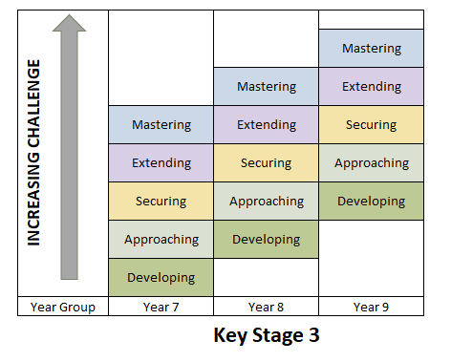
Assessment & Reporting
Notes:
Assessment is a regular part of lessons – and Teachers are constantly assessing how pupils are progressing through the curriculum. This is done through questioning, low stakes quizzes, written work and then more formal tests. There are more formal assessments in each subject – we aim to do this in a supportive way. Students are given dates in advance, helped to prepare and encouraged to revise and prepare in advance.
In Year 7 students are set targets based on a range of information – KS2 SATs, our own internal systems. Achievement of this target is considered good progress, and the target is intended to stay with them as they move through Years 7, 8 and 9 as the curriculum becomes increasingly challenging.
We report on this 3 times per year – you will find out how your child is progressing and will given information on 2 things: current (where they are currently working) and predicted (what the Teacher thinks they will achieve by the end of the year.

Slide 16
Using Classcharts and MCAS

Slide 17
iPayimpact
Notes:
Please can you add this document to a slide. Parents need an account reference from us, so this is really just to encourage them to sign up and email admin@stbb.org.uk for their account reference.

Slide 18
R | I | S | E
RESPECT RESILIENCE | INTEGRITY | SELF DISCIPLINE | EXCELLENCE

Slide 19
Thank You www.st-benetbiscop.org.uk
R | I | S | E
RESPECT RESILIENCE | INTEGRITY | SELF DISCIPLINE | EXCELLENCE

